Slide 1
CareerOneStop
Notes:
CareerOneStop – your source for career exploration, training, and jobs
CareerOneStop is sponsored by the U.S. Department of Labor Employment and Training Administration (ETA).
This presentation is intended to provide you with an overview of the CareerOneStop suite of sites and highlight various online resources

Slide 2
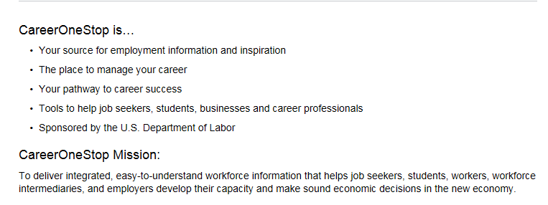
About CareerOneStop
Notes:
CareerOneStop is a national Web site that offers career resources and workforce information to job seekers, students, businesses, and workforce professionals.
CareerOneStop contains a set of online tools that integrate economic and workforce development activities and support talent development and success.

Slide 3
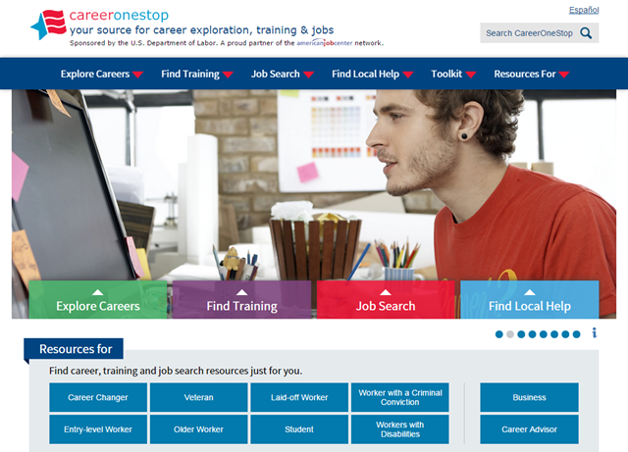
Your source for career exploration, training & jobs
Notes:
CareerOneStop has been significantly updated over the last couple years. The new look is based on user feedback and offers access to the key tools and resources from mobile devices as we transition to a fully responsive platform.
The new organization offers quick and easy access to valuable content.
You can find all the CareerOneStop and related tools you need in three simple groupings
Three Key Categories
Explore Careers
Find Training
Job Search
Centralized Tools (also available from within the Key topic areas)
Find Local Help
Toolkit
Audience Specific
Resources For

Slide 4
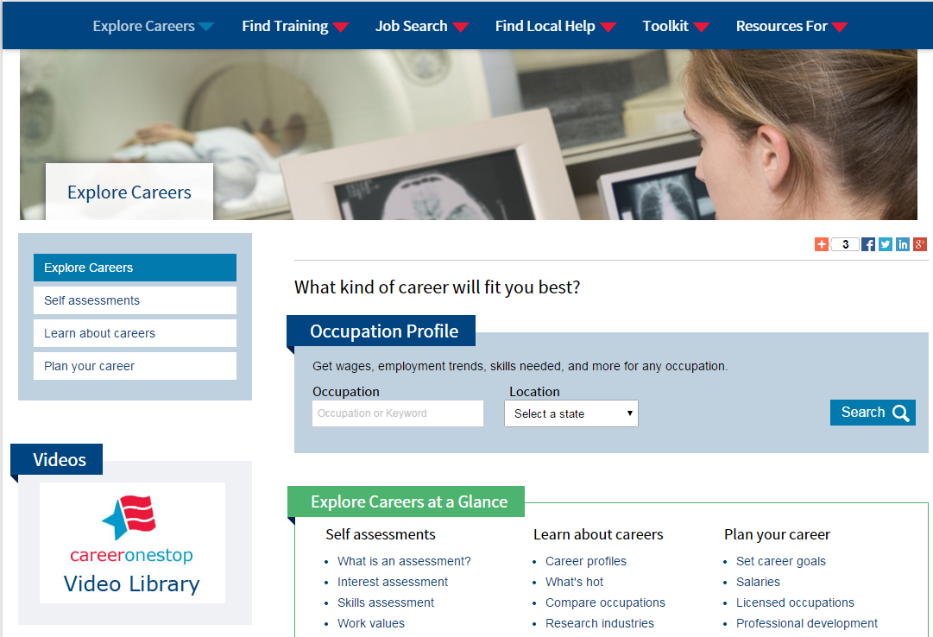
Explore Careers
Notes:
Three Main Sections in the Explore Careers Category
Self assessments
Learn about careers
Plan your career
Highlighting the Occupation Profile as a key tool in this category

Slide 5
Career Videos
Notes:
Videos in all shapes and sizes –
The career videos are currently in the process of being re-done to update technologies and occupations
Other videos also available cover things such as skills and abilities, industries and work options
More than 500 updated brand new videos
New Career Cluster videos

Slide 6
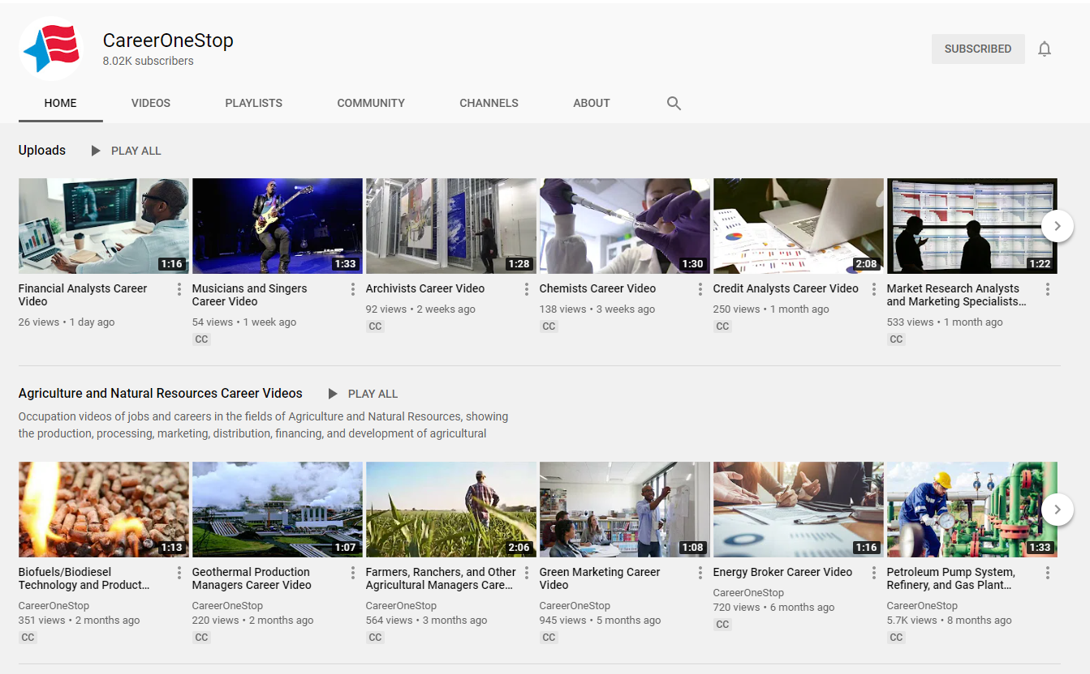
Career Videos - YouTube
Notes:
Videos in all shapes and sizes –
The career videos are currently in the process of being re-done to update technologies and occupations
Other videos also available cover things such as skills and abilities, industries and work options
More than 500 updated brand new videos
New Career Cluster videos

Slide 7
Credentials Center
Notes:
CareerOneStop also provides a Credentials Center, focused on Training and Education
https://www.careeronestop.org/Credentials/index.aspx

Slide 8
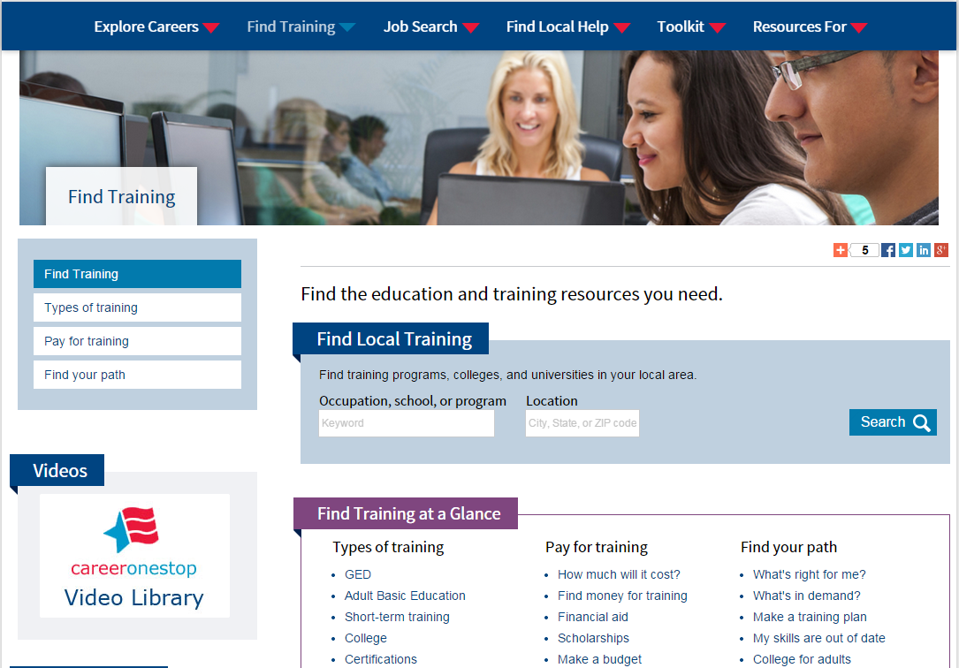
Find Training
Different types of training
Pay for training
Find your path
Notes:
Find training covers the education and training resources
Different types of training
Pay for training
Find your path
Highlighting the Local Training Finder as a key tool in this category

Slide 9
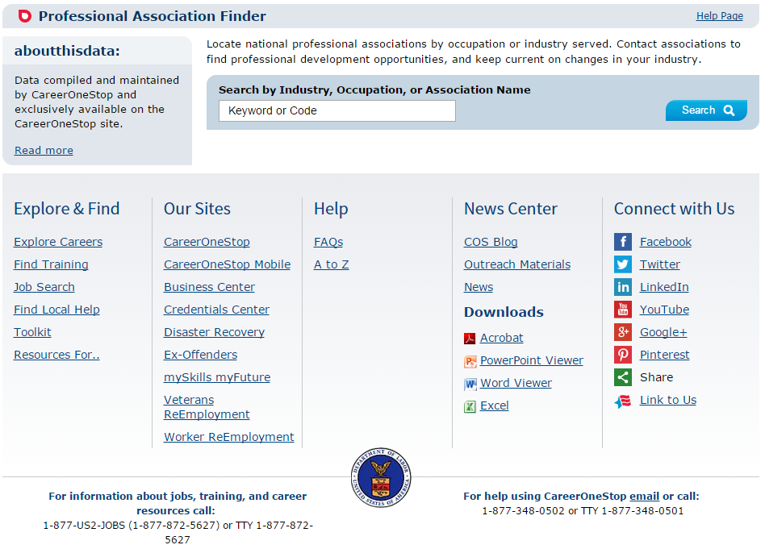
Professional Associations
Notes:
Example of a unique tool available for finding national professional associations by occupation or industry served.
Contact associations to find professional development opportunities, and keep current on changes in your industry.
https://www.careeronestop.org/toolkit/training/find-professional-associations.aspx

Slide 10
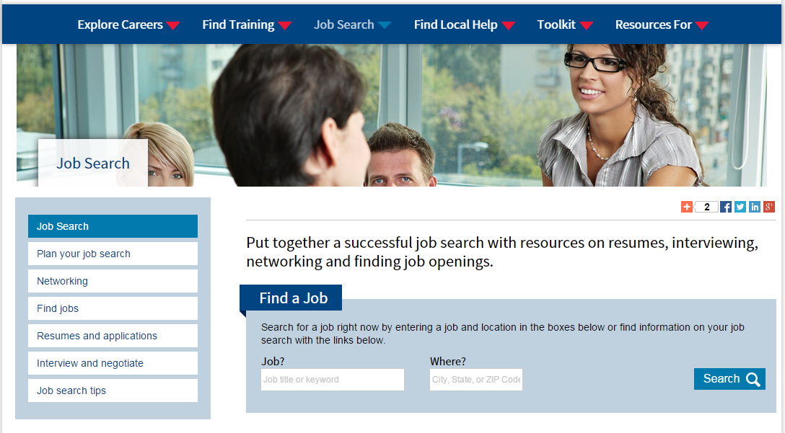
Job Search
Notes:
Six main sections within Job Search
Plan your job search
Networking
Find Jobs
Resumes and applications
Interview and negotiate
Job Search Tips
Everything needed for a successful job search
Highlighted tool in this category is the Job Finder

Slide 11
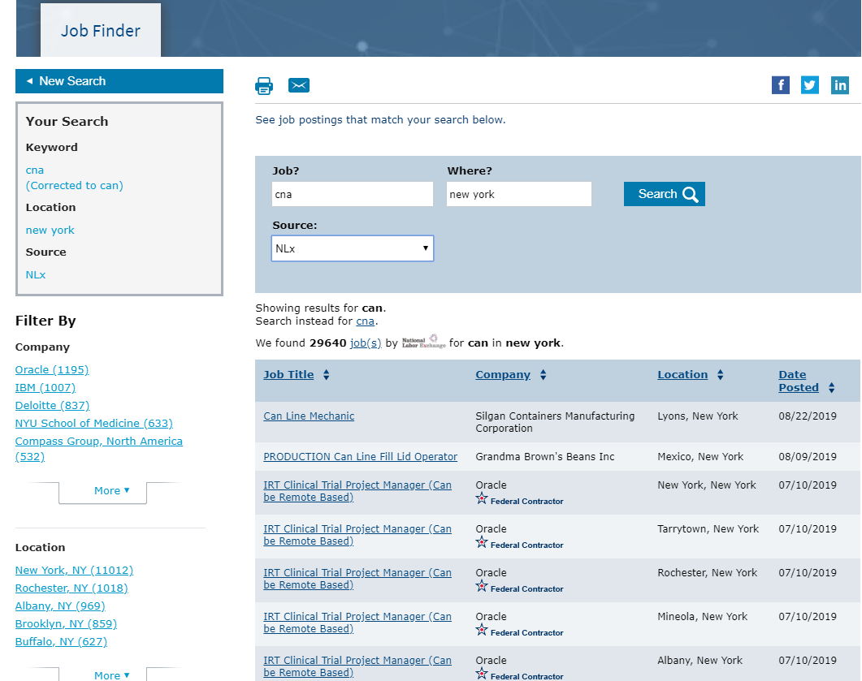
Job Finder
Notes:
The Job Finder tool is updated with job postings daily
You can select to view postings from three sources:
NLX
America's Job Exchange
CareerBuilder
Indeed

Slide 12
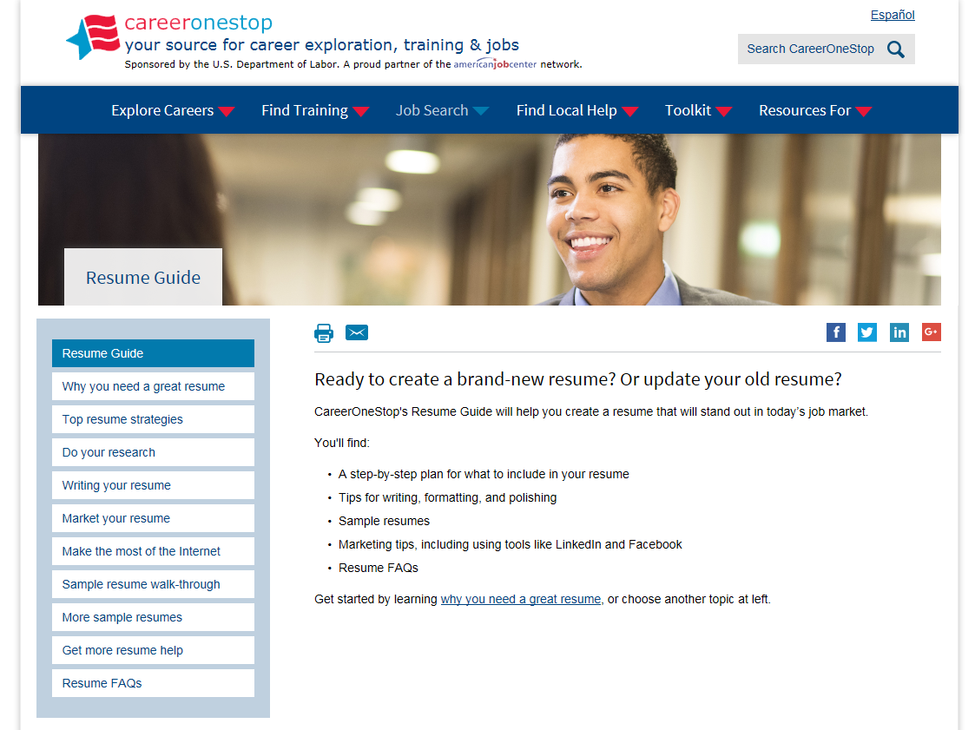
Resume Guide
Notes:
The Resume Guide covers
Step-by-step plan for what to include in a resume
Tips
Samples
FAQs

Slide 13
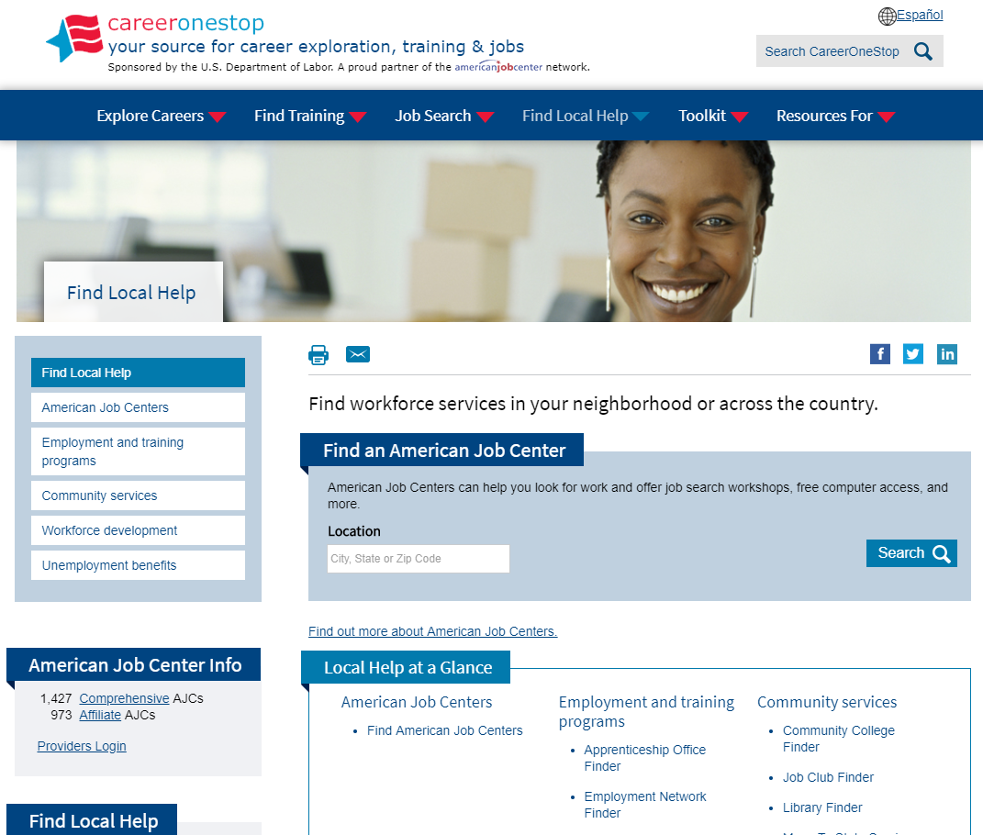
Find Local Help
Tools include finding:
American Job Centers
Unemployment Benefits Info
Workforce System Partners
Employment & Training Programs
….and more!
Notes:
The Find Local Help section provides access to various national and state programs such as Unemployment Benefits, Workforce development, and Employment & Training Programs.
The highlighted tool for this section is the American Job Center Finder

Slide 14
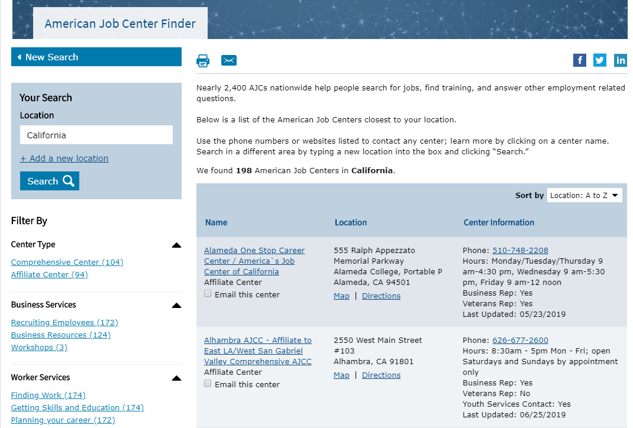
American Job Center Finder
Notes:
The American Job Center Finder helps locate centers in specific areas, for specific needs and identifying resources available
American Job Centers can help you look for work and offer job search workshops, free computer access, and more.
American Job Centers (AJCs) provide free help to job seekers for a variety of career and employment-related needs. Nearly 2,400 AJCs, funded by the U.S. Department of Labor’s Employment and Training Administration, are located throughout the United States.

Slide 15
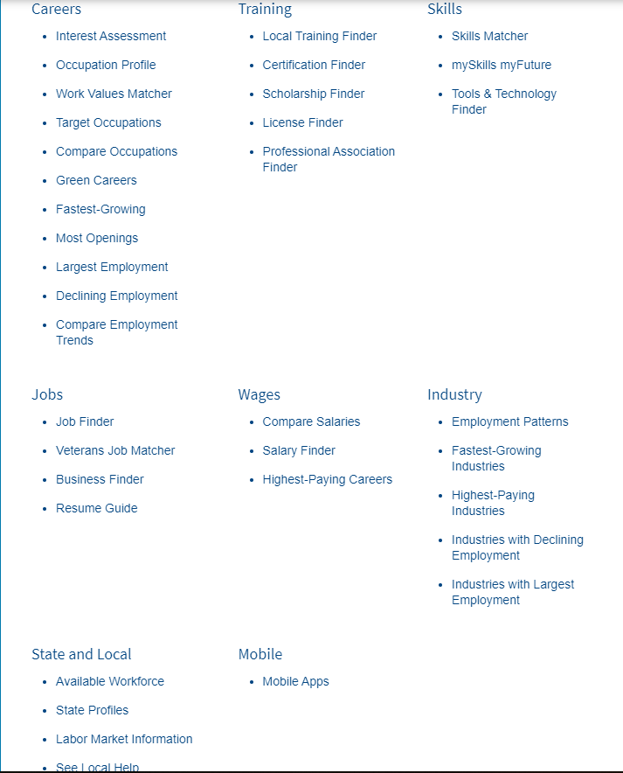
Toolkit
Tools include:
Occupation Profile
Interest Assessment
Local Training Finder
Work Values Matcher
Scholarship Finder
Salary Finder
Job Finder
….and more!
Notes:
CareerOneStop maintains a suite of tools that assist with career exploration, training, and job search activities.
The toolkit offers access to the tools from one centralized location, organized by topic.

Slide 16
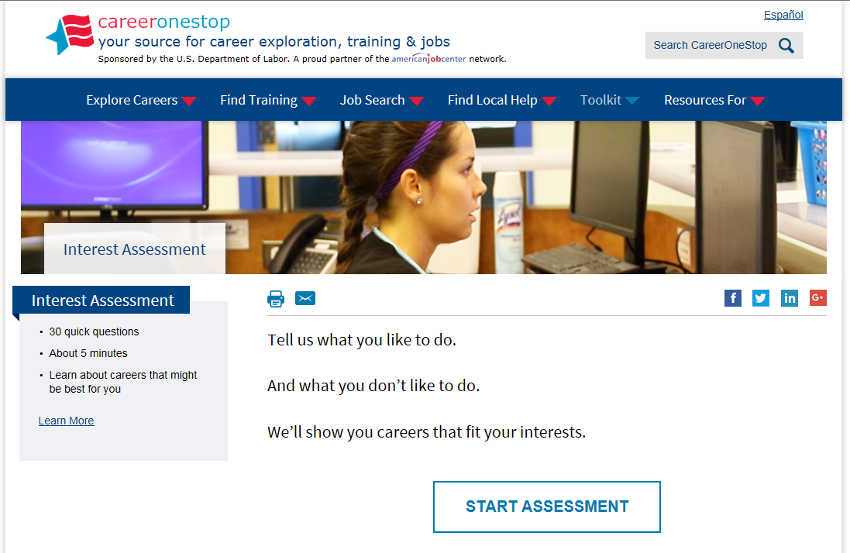
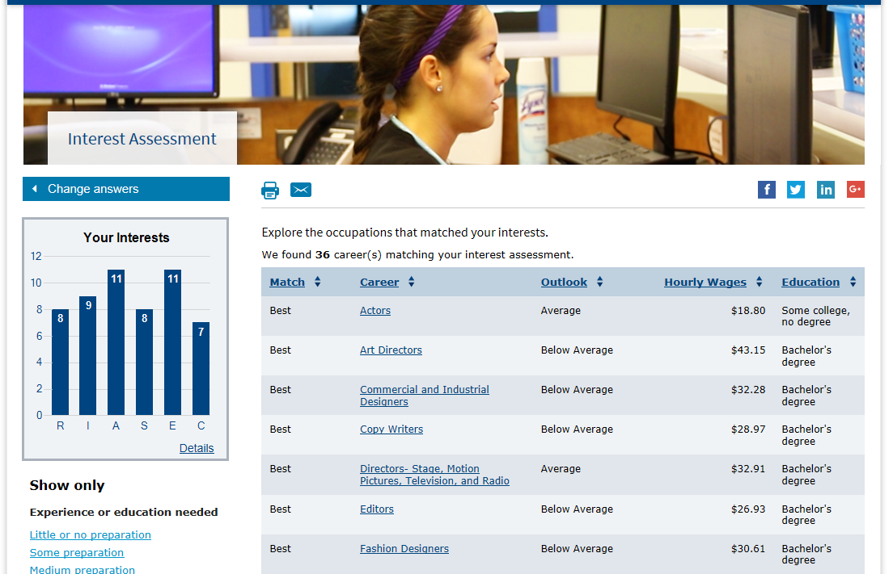
Interest Assessment
Notes:
One of our most recent additions is a new and enhanced Interest Assessment –
Answer 30 questions, RIASEC results and careers that may fit your interests
https://www.careeronestop.org/toolkit/careers/interest-assessment.aspx
There are two versions, the regular interest assessment and a version on the GetMyFuture website for youth – which is shown here

Slide 17
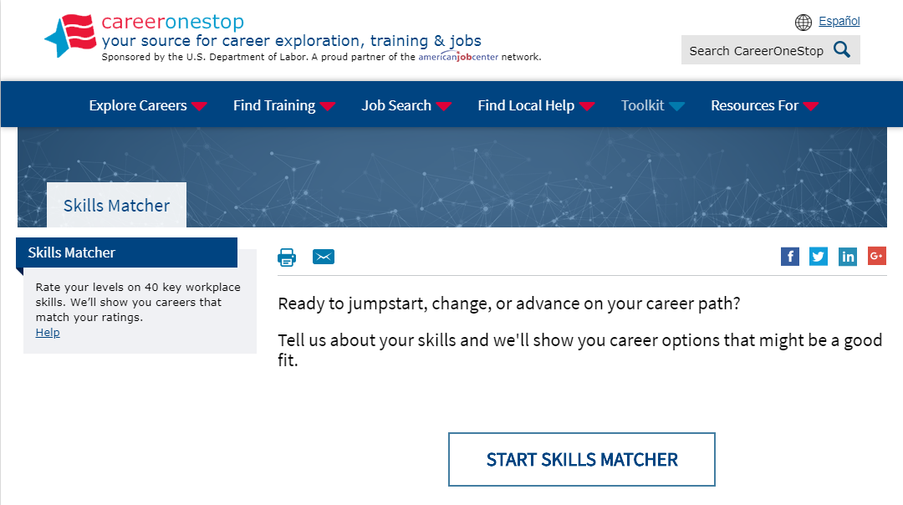
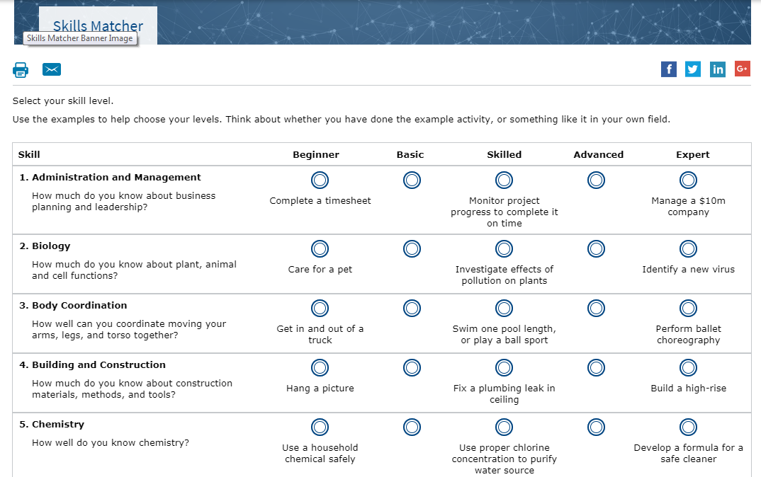
Skills Matcher
Notes:
The Skills Matcher helps you identify careers that match your skills. You answer 40 questions to rate your level in a range of skills. Then you see a list of careers that are good matches for your unique set of skills.
From there, you can explore the careers on your list of matches. You can learn about average pay, typical education, and the outlook (new job opportunities expected) for jobs in that field.

Slide 18
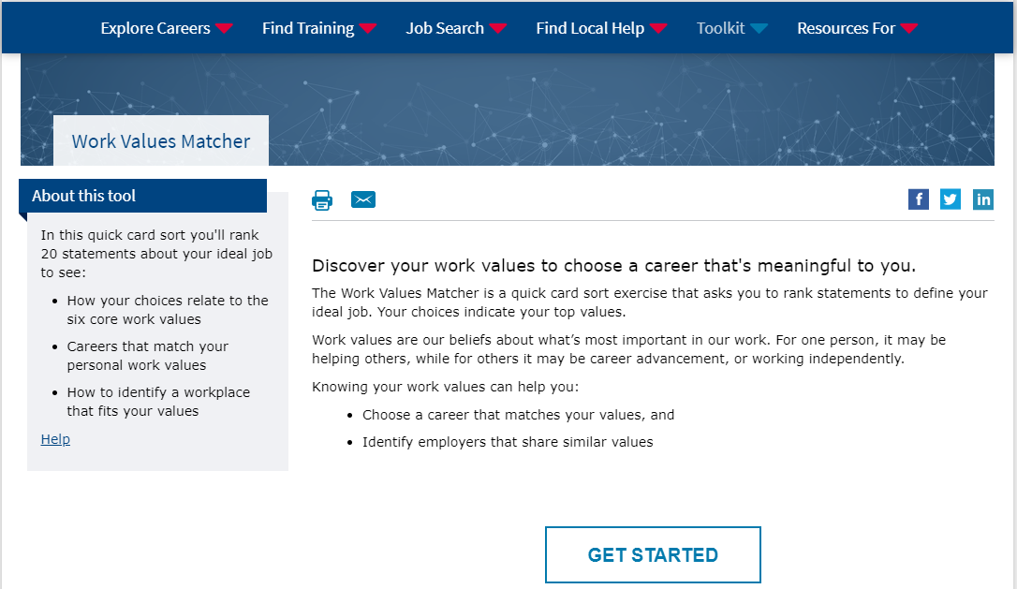
Work Values Matcher
Notes:
The Work Values Matcher is a quick card sort exercise that asks you to rank statements to define your ideal job. Your choices indicate your top values.
Work values are our beliefs about what’s most important in our work. For one person, it may be helping others, while for others it may be career advancement, or working independently

Slide 19
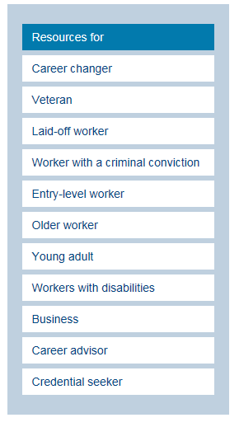
Resources For…
CareerOneStop offers resources targeted just for each of the audiences to the left!
Notes:
In partnership with other U.S. Department of Labor programs, CareerOneStop also offers audience specific sub-sites for some of the targeted audiences.

Slide 20
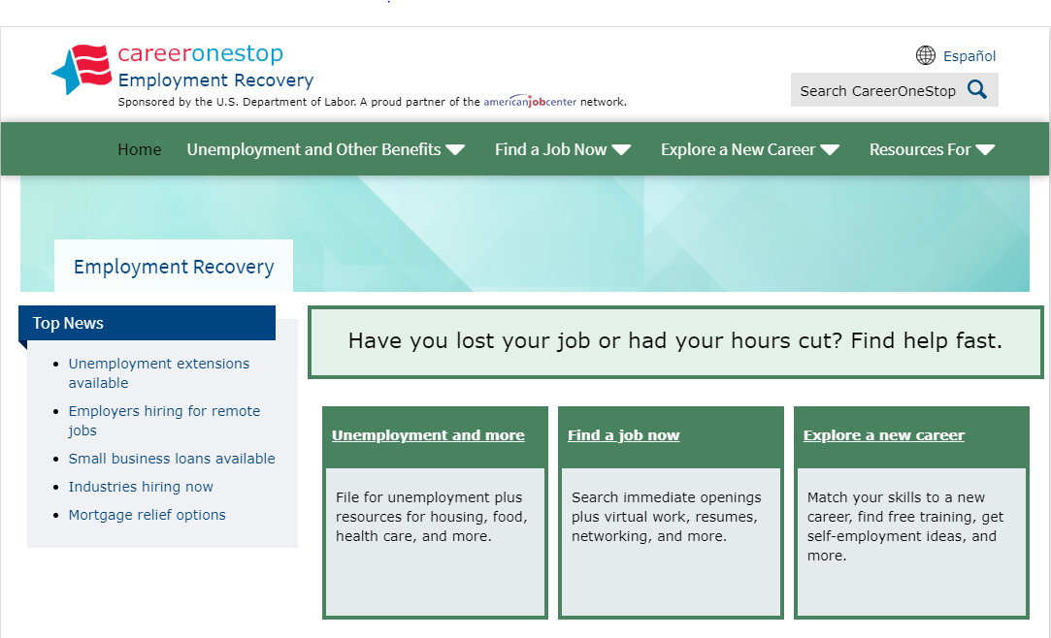
Employment Recovery
Notes:
Have you lost your job or had your hours cut? Find help fast

Slide 21
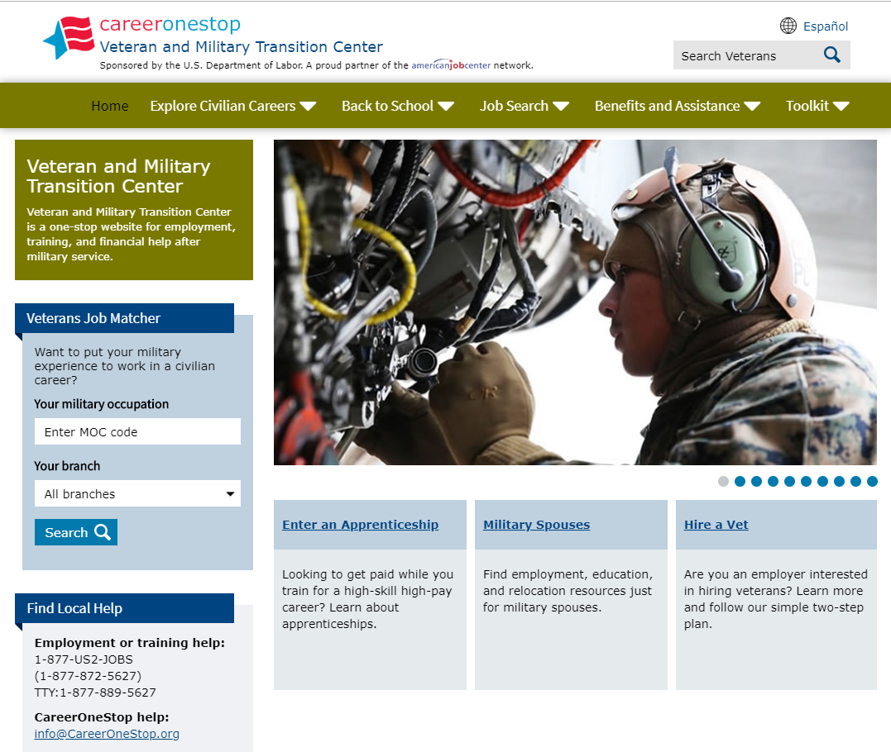
Veteran and Military Transition Center
Notes:
CareerOneStop’s Veteran and Military Transition Center (https://www.careeronestop.org/Veterans/default.aspx) is a site for employment, training, and financial help after military service.
The highlighted tool, Military-to-Civilian Job Search provides veterans to find current openings where they
can put their military skills and experience to work.

Slide 22
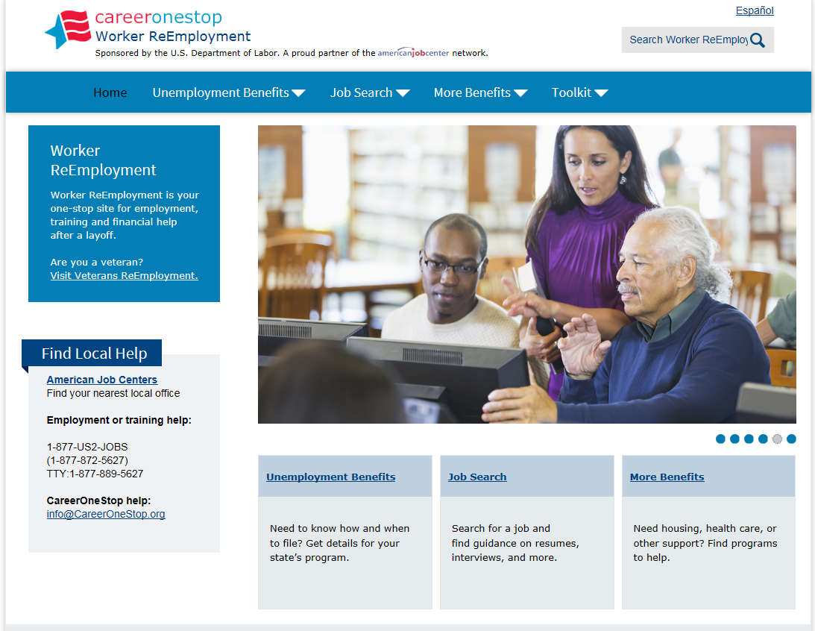
Worker ReEmployment
Notes:
The CareerOneStop Worker ReEmployment portal has been redesigned to streamline access to key resources for recently
laid-off workers, those receiving unemployment benefits, and those who have exhausted their benefits.
Visit https://www.careeronestop.org/WorkerReEmployment/default.aspx
for answers to questions about available government programs, local support, and job search assistance.

Slide 23
GetMyFuture
Notes:
What can you do on the GetMyFuture website?
https://www.careeronestop.org/GetMyFuture/index.aspx
The goal of this site is to help young adults overcome barriers and plan and achieve a path to career success.
Explore the site using the navigation labels across the top—or jump right to our different types of resources below.
This website has information, tools, and links to resources to help anyone age 16 to 24:
Explore careers
Learn about and locate training or education programs
Conduct a successful job search

Slide 24
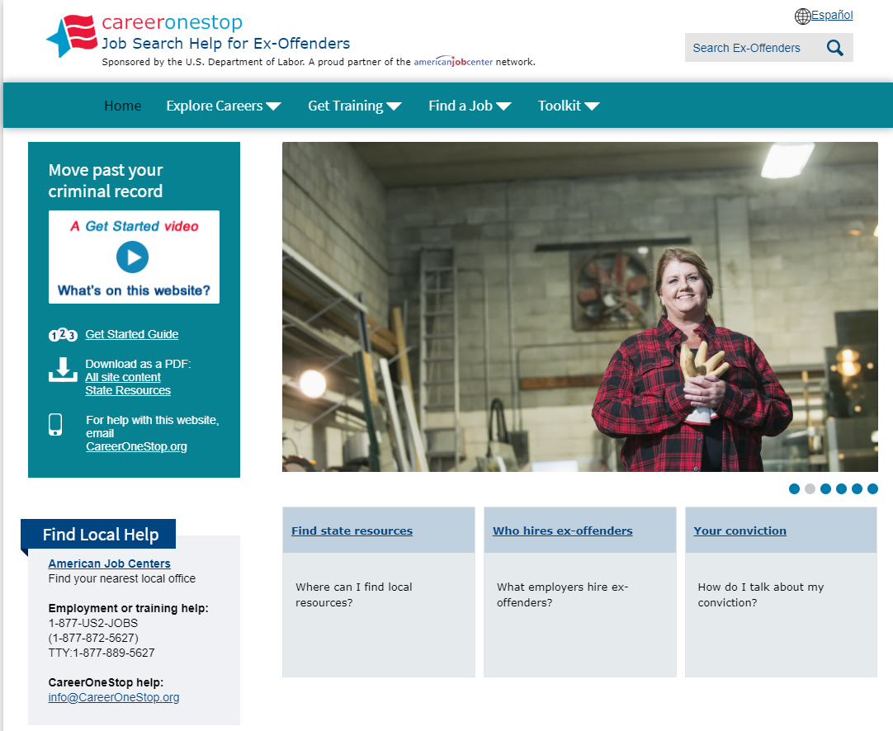
Ex-Offender
Notes:
Is a criminal record affecting your job search? CareerOneStop's Job Search Help for Ex-Offenders can help. https://www.careeronestop.org/ExOffender/index.aspx
CareerOneStop’s Job Search Help for Ex-Offenders website offers information, tips, and resources to help people with criminal convictions overcome barriers they might face in their job search including:
State-specific resources for help with basic needs or getting ready to job search
Work restrictions that apply to certain convictions
Paying for training or college

Slide 25
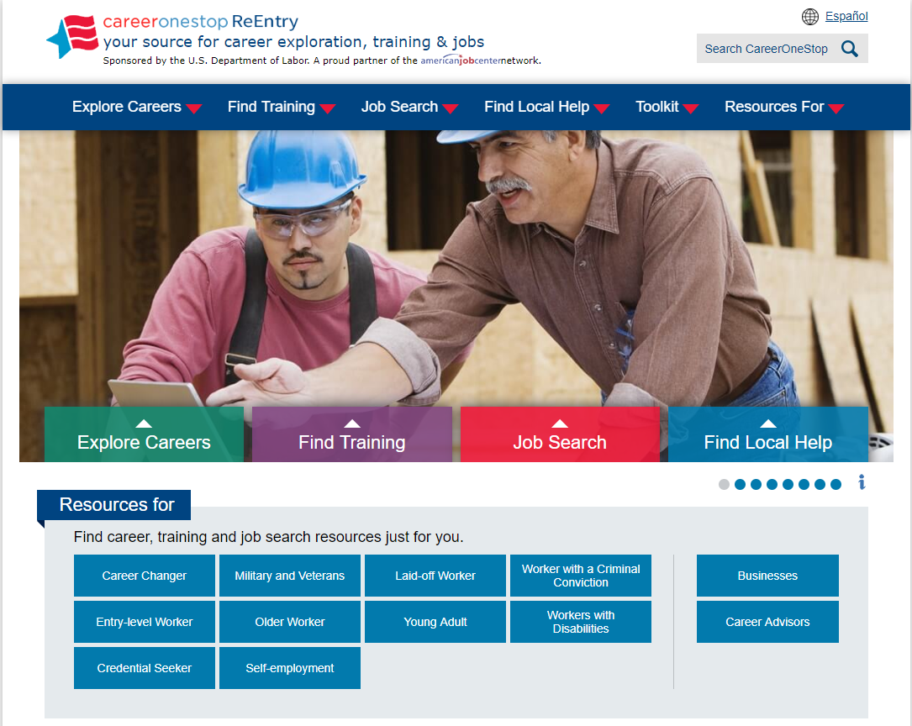
Reentry Portal
CareerOneStop announces ReEntry.CareerOneStop.org, an online, secure version of all CareerOneStop website content and tools, with all external links and maps disabled. The purpose of ReEntry.CareerOneStop is to provide correctional institutions and other secure facilities with access to CareerOneStop’s full range of career, training, and job search resources.
Notes:
ReEntry.CareerOneStop.org: online Job Search Help for Ex-Offenders, with external links disabled for use in secure facilities.
CareerOneStop announces ReEntry.CareerOneStop.org, an online, secure version of all CareerOneStop website content and tools, with all external links and maps disabled.
The purpose of ReEntry.CareerOneStop is to provide correctional institutions and other secure facilities with access to CareerOneStop’s full range of career, training, and job search resources.

Slide 26
www.mySkillsmyFuture.org
Laid-off workers and other career changers can:
Identify related careers to explore
Learn about transferable skills
Link to local training opportunities
View and apply for job listings
Notes:
Laid-off workers and other career changers can:
Identify related careers to explore
Learn about transferable skills
Link to local training opportunities
View and apply for job listings

Slide 27
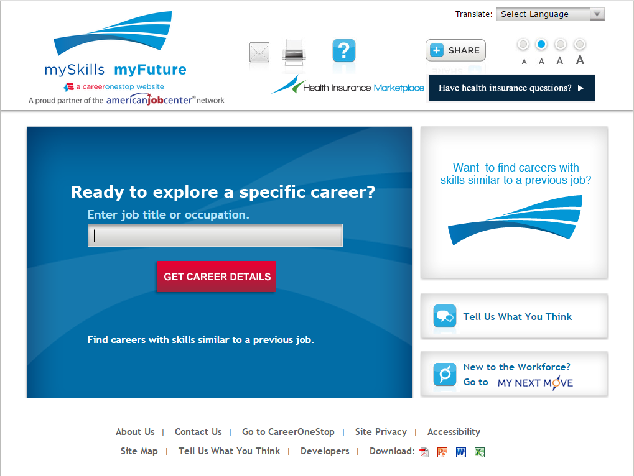
mySkills myFuture Target Occupation
Laid-off workers and other career changers who already know the career they want to explore can use the Target Occupation tool
Notes:
Search for information on a specific occupation

Slide 28
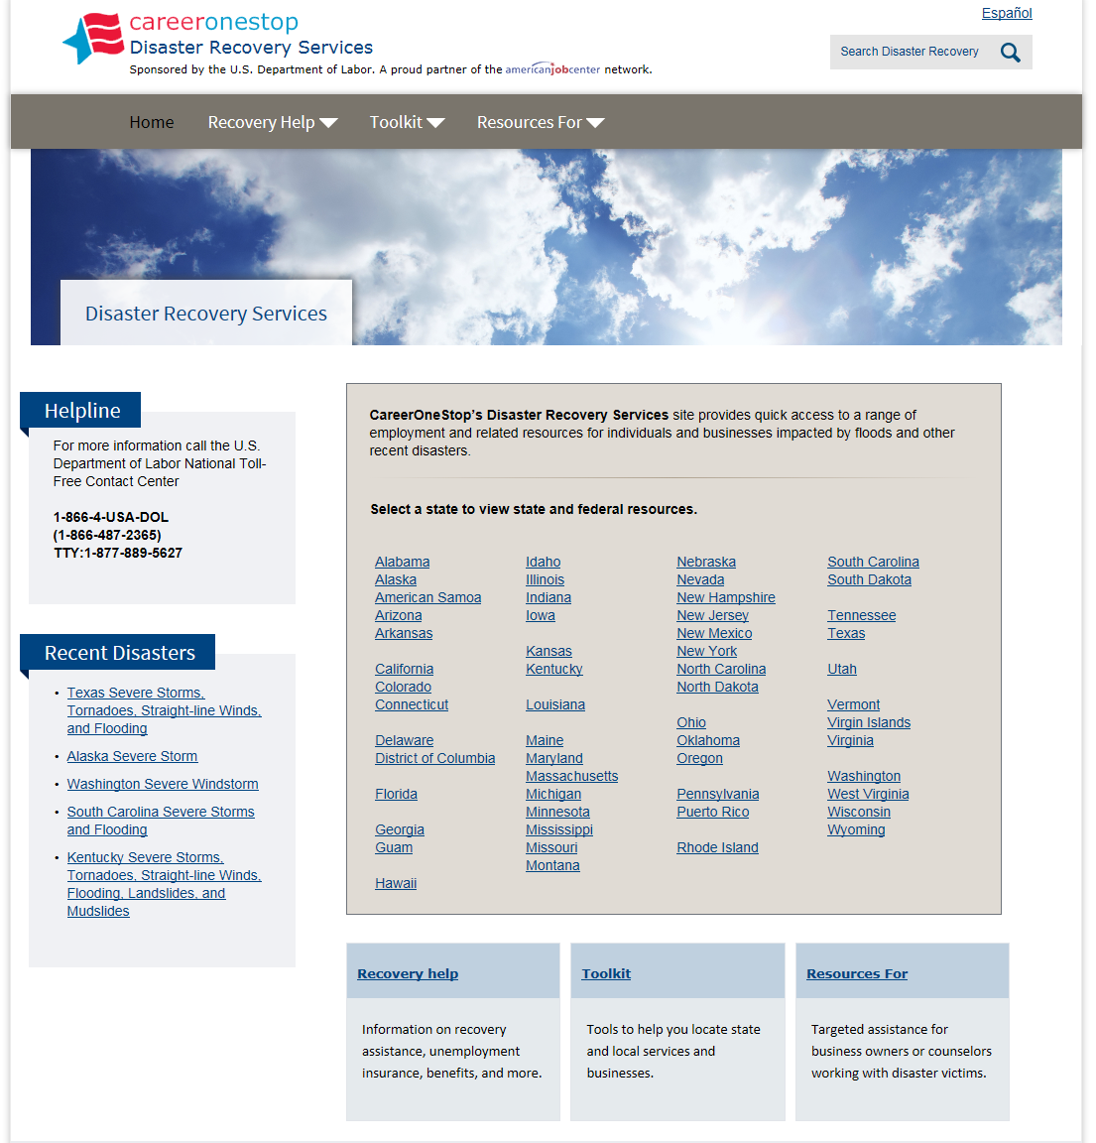
Disaster Recovery Services
Notes:
CareerOneStop’s Disaster Recovery Services site provides quick access to a range of employment and related resources for individuals and businesses impacted by floods and other recent disasters.
https://www.careeronestop.org/DisasterRecoveryServices/index.aspx

Slide 29
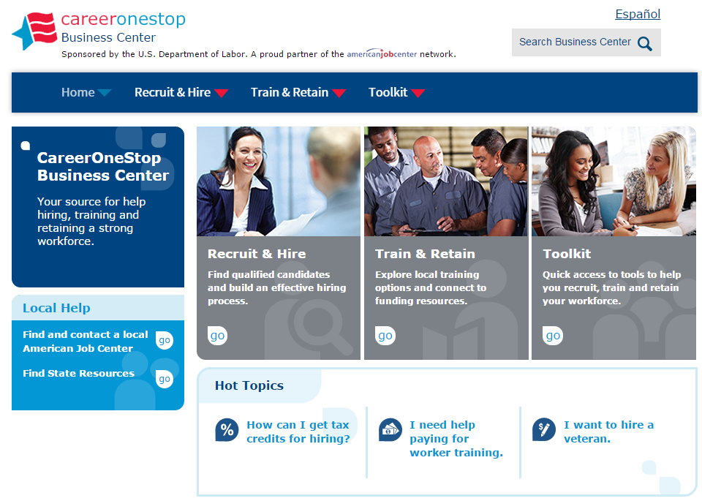
Business Center
Train and Retain
Hire and Recruit
ToolKit
Notes:
The CareerOneStop Business Center is the employer’s source for help hiring, training and retaining a strong workforce.

Slide 30
Competency Model
Notes:
The Competency Model provides the business community with a means to communicate its skill needs to educators and the workforce system in a common industry-driven framework.
Collaborative effort with business, education and government to define competencies in order to identify in-demand skills.
In their simplest form, Competency Models are a clear description of what a person needs to know and be able to do to perform well in a specific job:
Knowledge
Skills
Abilities
Competency models can also describe the requirements for:
Work roles
Groups of jobs/job families
Entire organizations/businesses
Industry sectors broad and specific
Features:
Easy online building tool
Quickly identify high-demand skills
High-growth Industry Models (Financial, Retail, & Advanced
Links to education models
Success stories
Benefits:
Disseminate the information
Eliminate redundancies
Develop consistencies
Build framework for standards, curriculum and certifications
Assist in decision making

Slide 31
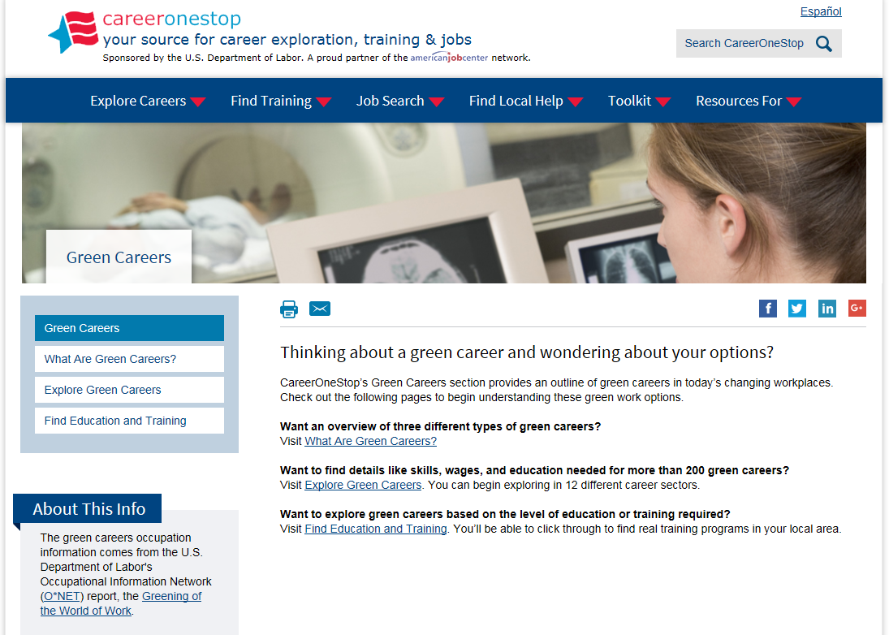
Green Careers
What are Green Careers?
Explore Green Careers
Find Education and Training for Green Careers
Notes:
CareerOneStop’s Green Careers section provides an outline of green careers in today’s changing workplaces. Check out the following pages to begin understanding these green work options.
Want an overview of three different types of green careers? Visit What Are Green Careers?
Want to find details like skills, wages, and education needed for more than 200 green careers? Visit Explore Green Careers. You can begin exploring in 12 different career sectors.
Want to explore green careers based on the level of education or training required? Visit Find Education and Training. You’ll be able to click through to find real training programs in your local area.

Slide 32
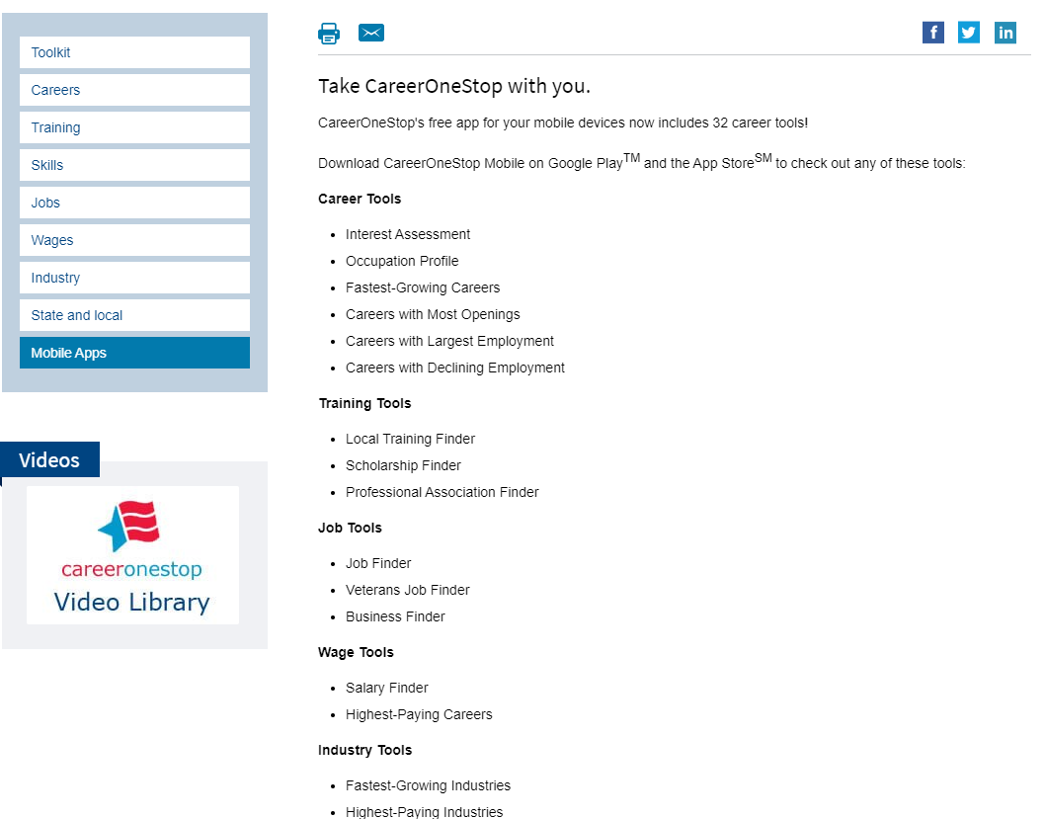
Mobile Tools
Notes:
You can now find CareerOneStop’s great resources in a easy way on your mobile device.
CareerOneStop now offers 32 mobile web applications:

Slide 33
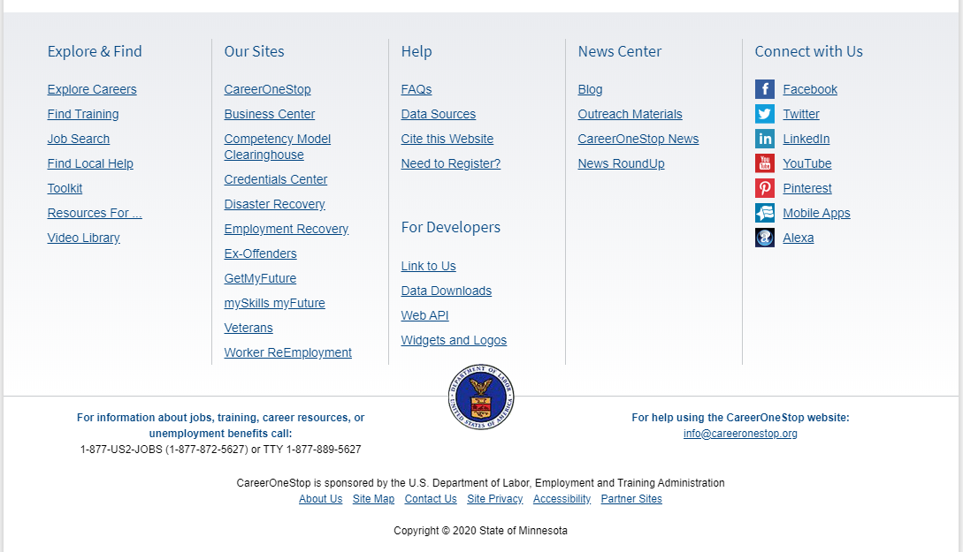
NewsCenter
Notes:
The CareerOneStop News Center covers three areas:
COS Blog
Outreach materials
News
News Roundup

Slide 34
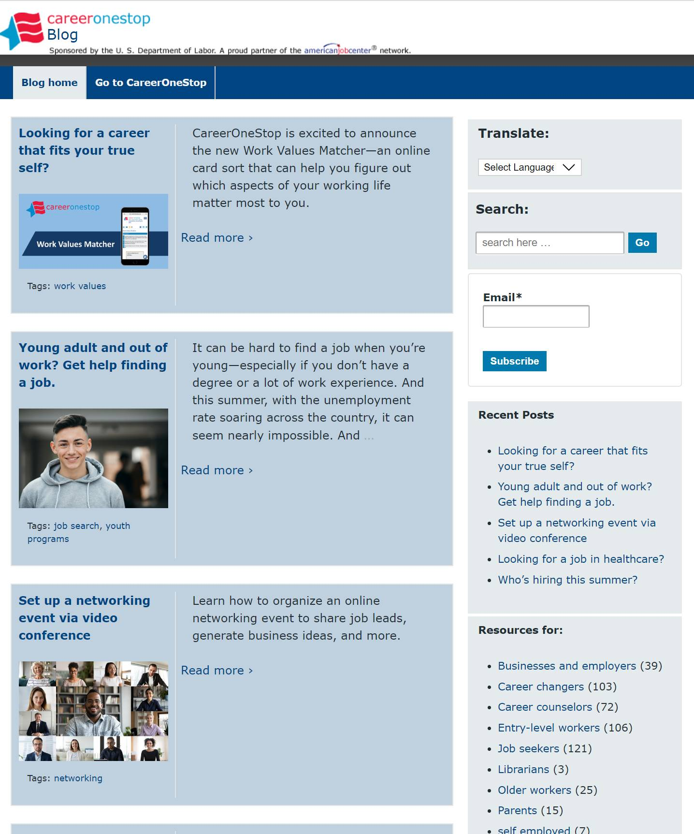
CareerOneStop Blog
blog.CareerOneStop.org
Notes:
Blogs are typically written weekly and can also be found in the Top News section on the COS home page
https://blog.careeronestop.org/

Slide 35
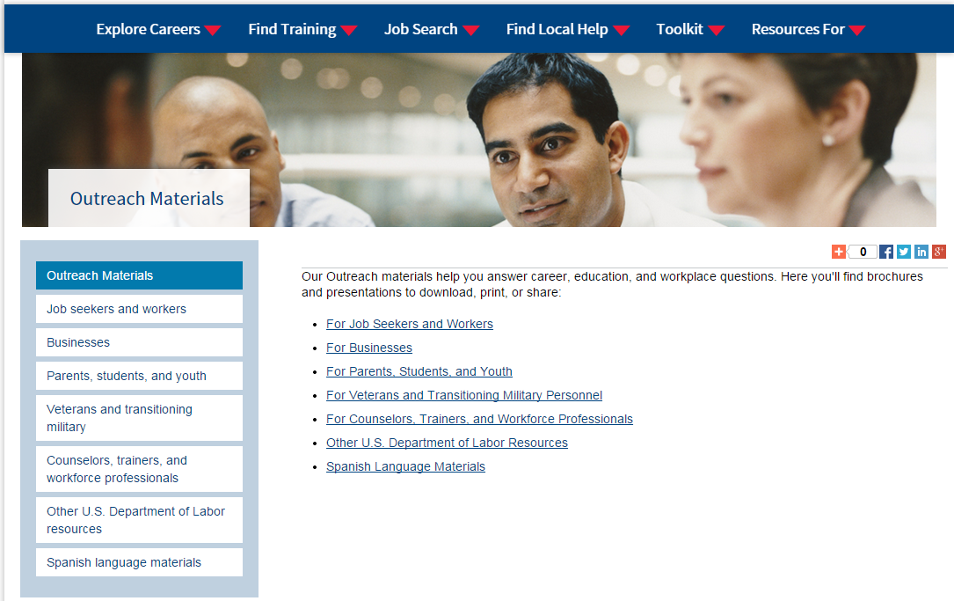
Outreach materials
Notes:
Our Outreach materials help you answer career, education, and workplace questions.
Here you'll find brochures and presentations to download, print, or share:
For Job Seekers and Workers
For Businesses
For Parents, Students, and Youth
For Veterans and Transitioning Military Personnel
For Counselors, Trainers, and Workforce Professionals
Other U.S. Department of Labor Resources
Spanish Language Materials
Let watch the intro video
https://www.careeronestop.org/outreach/outreach-materials.aspx

Slide 36
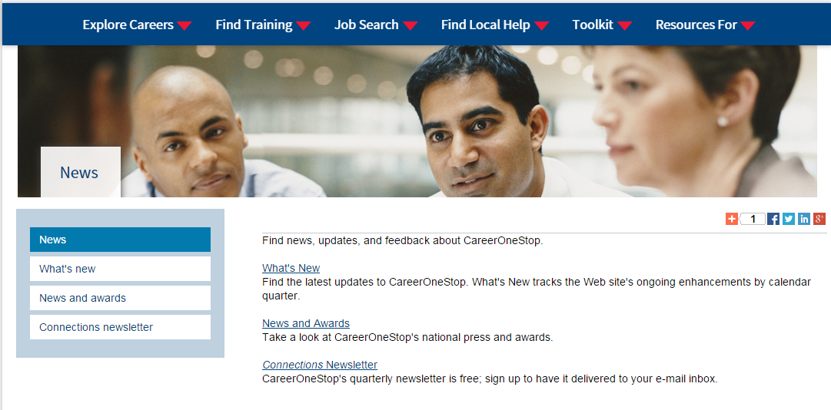
News
Notes:
Find news, updates, and feedback about CareerOneStop.
Also have a blog here: http://blog.careeronestop.org/

Slide 37
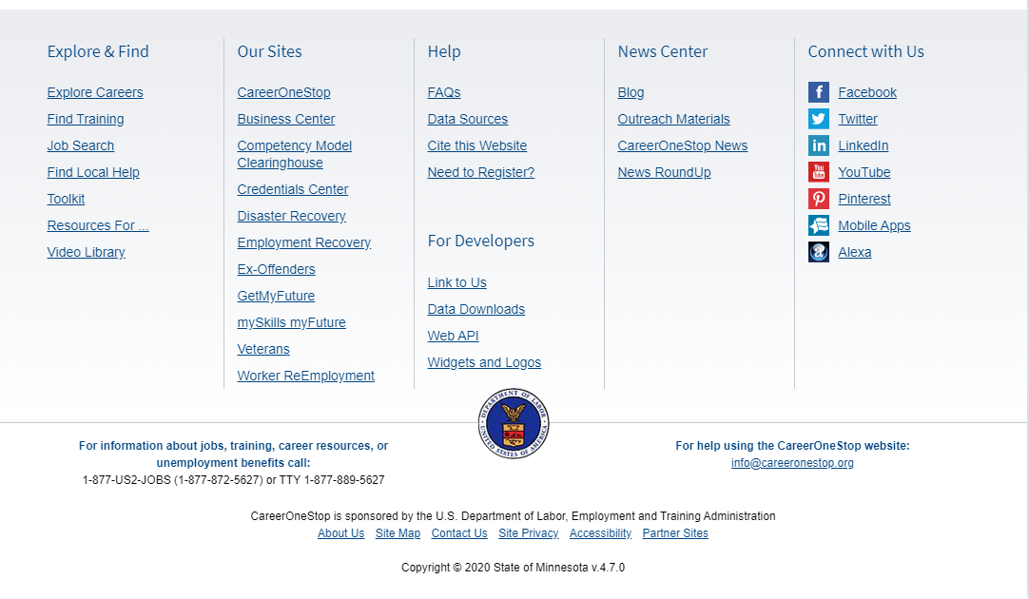
For Developers
Notes:
The For Developers section offers three different options for utilizing CareerOneStop’s range of career, education, and employment data
Data Downloads
Web APIs
Link to Us
4. Widgets and logos

Slide 38
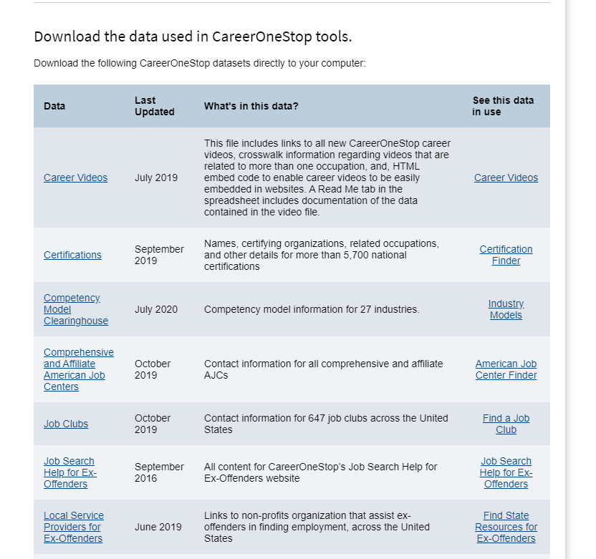
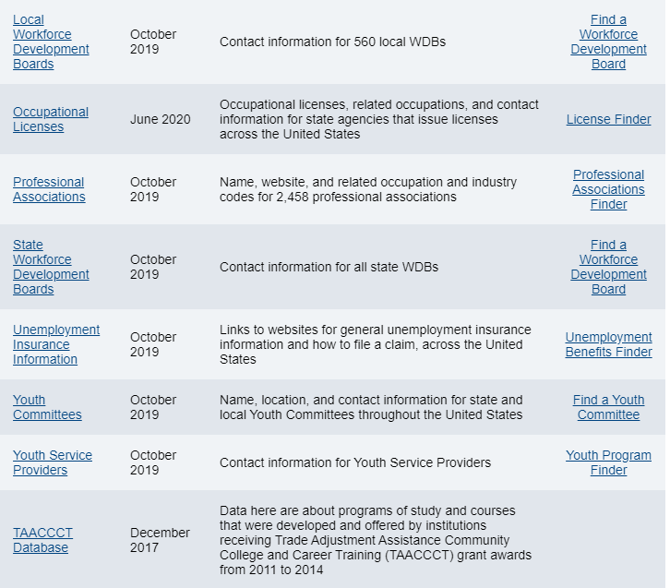
Data Downloads
Notes:
Data downloads provides access to the data files to use as you want

Slide 39
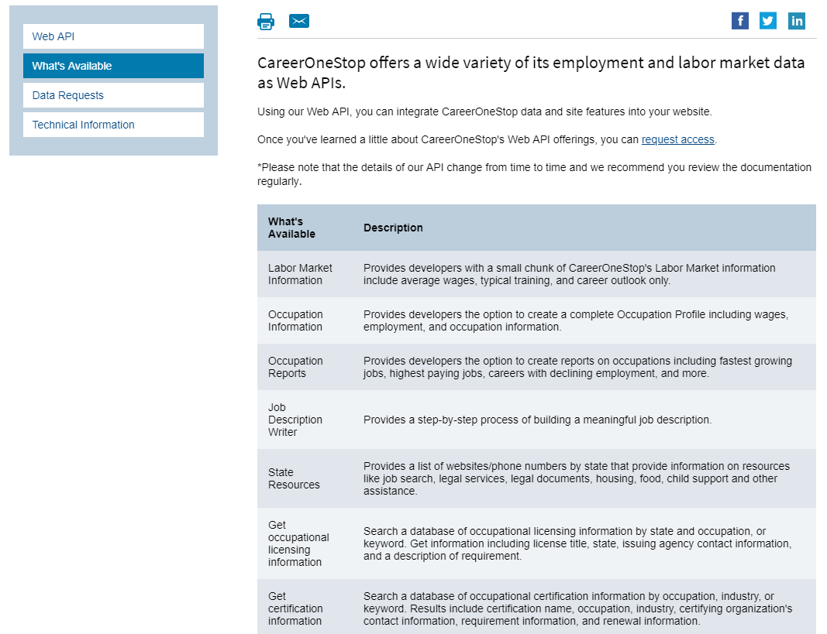
Web API
Notes:
CareerOneStop offers Web API as a way to exchange data, information, and even online tools seamlessly between Web sites.
CareerOneStop does the work of collecting and updating the data, while you display a customized version on your site.

Slide 40
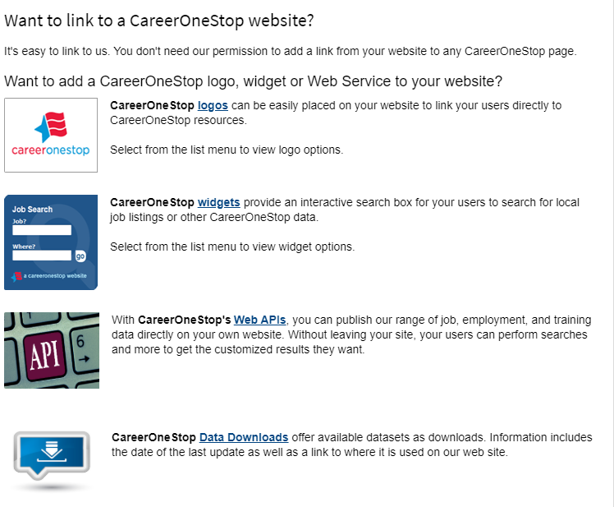
Link to Us
Notes:
Another option is to add a link from other sites and tap into the assets developed and maintained by CareerOneStop.

Slide 41
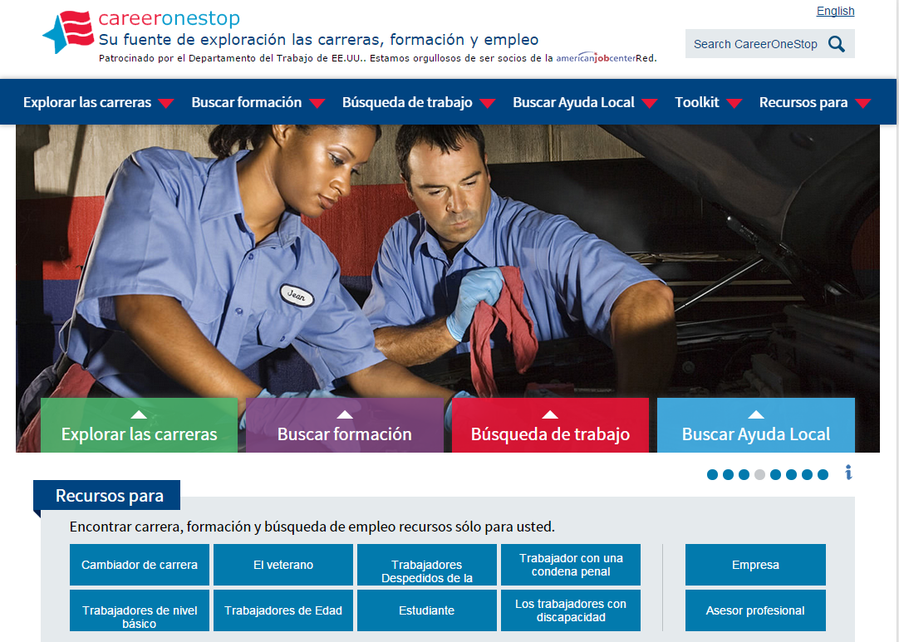
Spanish
Notes:
Our entire website can be translated into Spanish. Click in upper right corner.

Slide 42
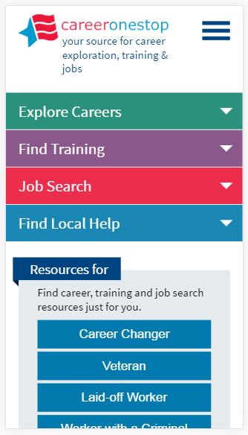
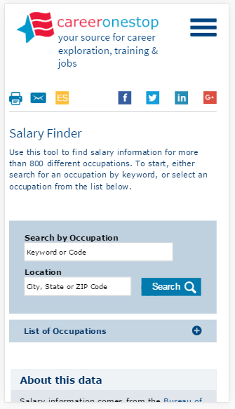
Responsive
Notes:
A large percentage of the content and tools have been made responsive to work from mobile devices

Slide 43
Chatbot
Did you know CareerOneStop now has a chatbot?
Hi, welcome to CareerBot.
I’m not a real person, but I can help you find what you need on the CareerOneStop website.
Please say Hi to get started.
Notes:
Chat with CareerOneStop
Did you know CareerOneStop now has a chatbot?
You’ll find CareerBot on every one of our web pages, whether you’re on a computer, tablet, or phone. Just look for the friendly icon in the lower right of your screen.
Ask CareerBot to help you find your favorite CareerOneStop resource—or, to discover something entirely new on any of CareerOneStop’s sites. You can use CareerBot’s menu or you can type in a question to find what you’re looking for. CareerBot will direct you to the CareerOneStop resource that best meets your needs. For some of CareerOneStop’s most-used tools—including the Job Finder, Salary Finder, and more—you’ll even find your results returned right inside your chat window.
CareerBot is a bot, not a real person—and still getting up to speed on the best way to help you navigate the wealth of information on CareerOneStop websites. So if you don’t find what you’re looking for the first time, please be patient and try again—and then send us an email at info@careeronestop.org to let us know what CareerBot can do better!

Slide 44
CareerOneStop on Social Media
Twitter: https://twitter.com/Career1Stop
LinkedIn: https://www.linkedin.com/company/careeronestop
Facebook: https://www.facebook.com/pages/Careeronestop/135511219941994
Instagram: https://www.instagram.com/careeronestop/
Pinterest: https://www.pinterest.com/CareerOneStop/
YouTube: https://www.youtube.com/user/CareerOneStop
Notes:
Find CareerOneStop on Social Media!

Slide 45
Resources
U.S. Department of Labor Employment & Training Administration: www.doleta.gov
CareerOneStop: www.careeronestop.org
GetMyFuture: www.GetMyFuture.org
Credentials Center: www.careeronestop.org/Credentials
Business Center: www.careeronestop.org/BusinessCenter
Veteran and Military Transition Center: www.careeronestop.org/Veterans
Worker ReEmployment: www.careeronestop.org/ReEmployment
Competency Model: www.careeronestop.org/CompetencyModel
mySkills myFuture: www.mySkillsmyFuture.org
Notes:
Print these page for easy access to our web sites!

Slide 46
Contact Us
Contact CareerOneStop
E-mail: info@CareerOneStop.org
US2-JOBS Toll-Free Help Line
1-877-US2-JOBS (TTY: 1-877-889-5627)
Notes:
Also available is an online form to complete, available from the Contact Us link in the footer of every page

